Slide 1

C Language Practical Project——A Small Game 2048
The Presentation From the 8th Group
Group leader: Peiqi Chen
Group Members: Jianqiao Zhang Kaiwen Zhao Liangting Ye

Slide 2

INDEX
1
Introduction
2
Primary Design
3
Improvement Design
4
Conclusion & Reflection

Slide 3

PART 1
Introduction
Brief Introduction for the Rules
The Game Loop
The Whole Design
The Analysis of the Main Operation
The Tasks Distribution in Group Members

Slide 4
Introduction
Brief Introduction for the Rules
Basic rules for the game:
1. Initially, we have 1 number on the board whose positions are randomized.
2. When numbers are moved towards one of 4 directions, a pair of the same number on the same row or column will be merged and summed up.
3. In the mean time, a new number will be added, which can be 2 or 4.
4. If the board is full and no more moves are available, the game ends.
5. Moreover，our group designs more operations to make the game more interesting, which will be mentioned later.

Slide 5
Introduction
The Game Loop
The game loop: (the graph can help to understand)
Game starts
Put one number on the board
Move up/down/left/right
Create one random number
Yes
Yes
Yes
Next moves available
Empty slots exist
Board unchanged
Game ends
No
No
No

Slide 6
Introduction
The Whole Design
Primary Design
1. We decide on one two-dimensional array(4*4) and one auxiliary array as the main tool.
2. The functions that we need to use:
game_interface(): to print the game interface
create_random(): to create a random number after one movement if empty slot exists
basic_fun(): to achieve the basic operation that will be mention later
judge_fun(): to judge whether the game ends
3.In the main function, we use the while statement and switch statement to transform the operation in keyboard into the change of the board.

Slide 7
Introduction
The Whole Design
Improvement Design
1. To increase the interest of the game, we design more functions to achieve “save”, ”load” and “regret”operations. And we want to make the game continue when player wins.
2. we use structure array and pointer to replace two-dimensional array and auxiliary array.
3. The functions that we add:
save(): to save the current 16 numbers load(): to load the last game record that has been saved regret(): to withdraw the last step if the “regret time” is bigger than zero
initialization():to initialize the structure array
4. We text our project with the help of debug.

Slide 8
Introduction
The Analysis of the Main Operation
Of course, the primary operation in the game is to achieve the change of the board When numbers are moved towards one of 4 directions.
For instance, we will take one row to break down the operations:
1
Operation 1: eliminate zero
Move right
2
Operation 2: combine
2
0
2
8
0
0
4
8
1
2
2
0
2
8
0
2
2
8
0
0
4
8
Move right
2
2
4
4
0
0
4
8
2
1
2
2
4
4
0
4
0
8
0
0
4
8

Slide 9
Introduction
The Tasks Distribution in Group Members
Group leader: Peiqi Chen (major in math) 33160131
Design the main function (1/2)
Test the project to find and rectify the bug
Add more functions (save, load, regret) and make the game continue when player wins
Write the second version of the project with structure array
Group member: Jianqiao Zhang (major in math) 31161203
Find out solution in the book/Internet for the problems we faced
Design the main function (1/2)
Design the basic function (eliminate zero and combination)（1/2）
Group member: Kaiwen Zhao (major in math) 31160820
Design the game_interface function
Design the create_random function
Group member: Liangting Ye (major in physics) 32160901
Design the judge_fun function (including judge_1_fun function and judge_2_fun function)
Design the basic function (eliminate zero and combination)（1/2）
Check and combine the separated parts together to make the whole statement consistent

Slide 10
PART 2
Primary Design (version 1)
The Initial Setting
The Main Function

Slide 11
Primary Design（version 1）
The Initial Setting
In this part, we will present you the earliest vision code only with basic operations.
The global variables:
The head resources
#define WIN 2048
int array[4][4]={0,0,0,0,0,0,0,0,0,0,0,0,0,0,0,0};
int aux_array[5]={0,0,0,0,0};
int judge_1_array[5]={0,0,0,0,0};
int step=0;
int score=0;
int max=0;
int judge_1=1; //whether Next moves available
int judge_2=1; //whether Empty slots exist
#include"create_random.h"
#include"game_interface.h"
#include"basic_fun.h"
#include"judge_fun.h"

Slide 12
Primary Design（version 1）
The Main Function
int main()
{
int i,j,a,b,temp;
char operation_1;
srand((unsigned)time(NULL));
max=0;
create_random();
while(max<WIN)
{
system("cls");
game_interface();
operation_1=getch();
switch(operation_1)
{
case 'w':
case 'W':
temp=0;
for(i=0;i<=3;i++)
{
for(j=0;j<=3;j++)
{
aux_array[j]=array[j][i];
}
basic_fun();
for(j=0;j<=3;j++)
{
if(array[j][i]!=aux_array[j])
temp=1;
array[j][i]=aux_array[j];
}
}
if((judge_2==1)&&(temp==1))
{
create_random();
}
break;
assign the
auxiliary array
local variables& assignment
operate the
auxiliary array
change the board
assign the
two-dimensional array
transform the operation in key
create one random number
judge the change of the board

Slide 13
Primary Design（version 1）
The Main Function
（the other directions are similar）
} //the end of “switch”
a=judge_1_fun_1();
b=judge_1_fun_2();
judge_1=(a>b)?a:b;
judge_2=judge_2_fun();
if((judge_2==0)&&(judge_1==0))
break;
} //”the end of while”
system("cls");
game_interface();
if(max>=WIN)
{
printf("Congratulations, you won!!\n");
printf("you did a really good job!!\n");
}
else
{
printf("so sorry that you lost the game\n");
printf("but it is a great try!\n");
}
return 0;
Whether the game ends

Slide 14
PART 3
Improvement (version 2)
The Structure Array & More Operations
The Part Code Presentation
A Small Video of the Project Execution

Slide 15
Improvement (version 2)
The Structure Array & More Operations
Then, we think that we can use the structure array to replace the two-dimensional array and auxiliary array
struct tnode
{
int number;
struct tnode *up;
struct tnode *down;
struct tnode *left;
struct tnode *right;
}array[16];
Structure pointers point the relevant structure
And, we design the other three operations and make the game continue when you win
save(): to save the current 16 numbers
load(): to load the last game record that has been saved
regret(): to withdraw the last step if the “regret time” is bigger than zero

Slide 16
Improvement (version 2)
The Part Code Presentation
void initialization(void)
{
int i,j;
for(i=0;i<=3;i++)
{
for(j=0;j<=3;j++)
{
array[4*i+j].number=0;
if(4*i+j-4>=0)
array[4*i+j].up=&array[4*i+j-4];
else
array[4*i+j].up=NULL;
(the other directions are similar)
}
}
}
Take “up” for instance
NULL
NULL
NULL
NULL
array[00]
array[01]
array[02]
array[03]
assign the address of the structure to the pointer
array[04]
array[05]
array[06]
array[07]
array[08]
array[09]
array[10]
array[11]
array[12]
array[13]
array[14]
array[15]

Slide 17
Improvement (version 2)
The Part Code Presentation
void save(void)
{
int i;
FILE *fp;
if((fp=fopen("save.txt","w"))!=NULL)
{
for(i=0;i<=15;i++)
{
fwrite(&array[i].number,sizeof(int),1,fp);
}
fclose(fp);
}
else
{
printf("problem opening the file\n");
}
}
write 1 number(int) into “save.txt” at one time

Slide 18
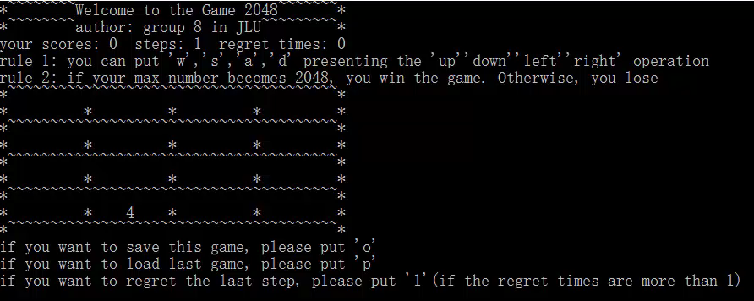
Improvement (version 2)
A Small Video of the Project Execution

Slide 19
PART 4
Conclusion & Reflection

Slide 20
Conclusion & Reflection
1.Through the program, we are familiar with the functions and grammars of the computer.
2.Learning how to design an integrated program ourselves rather than the single function practice.
3.When we face the problems, we find books and look through the internet by which we know how to learn more knowledge.
4.When we correct our program, we see more bugs and we know how to correct it.
5.Our program is still simple, we can add more functions and make the interface more beautiful.

Slide 21
THANK YOU

